Slide 1
IT2402-Free and Open Source Software Solutions
ARCHITECTURE OF LINUX SYSTEM

Slide 2
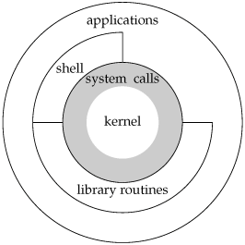
Architecture of Linux

Slide 3
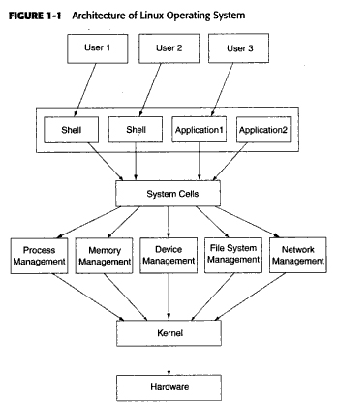

Slide 4
Kernel
Heart of the operating system
Every operation is performed using the kernel
When the Kernel receives requests from the Shell, it process the request and gives result

Slide 5
Shell
An interface program which is used to execute commands
Interface between user and the kernel
Text-based command-line interpreter
bash is the default Linux shell

Slide 6
Library routines
subroutine, procedure, function etc.
Stored in program library

Slide 7
System calls
Used to interact with the operating system
A program makes a system call when it makes a request from the operating system’s kernel

Slide 8
Working with Shell
Shell Types
sh
bash
csh
tcsh
Korn shell (ksh)

Slide 9
Exercise
View valid shell types
Try
cat /etc/shells
Switch from one shell to another
Try
bash
sh
What is meant by the $/ # / % symbols visible on the prompt?

Slide 10
Bash shell
Key Combinations of bash shell
Ctrl+a
Move cursor to the beginning of the command line.
Ctrl+c
End a running program and return the prompt .
Ctrl+d
Log out of the current shell session, equal to typing exit or logout
Ctrl+e
Move cursor to the end of the command line.
Ctrl+h
Generate backspace character.
Ctrl+I
Clear this terminal.

Slide 11
Exercise
What are the possible commands to view bash history?

